Slide 1
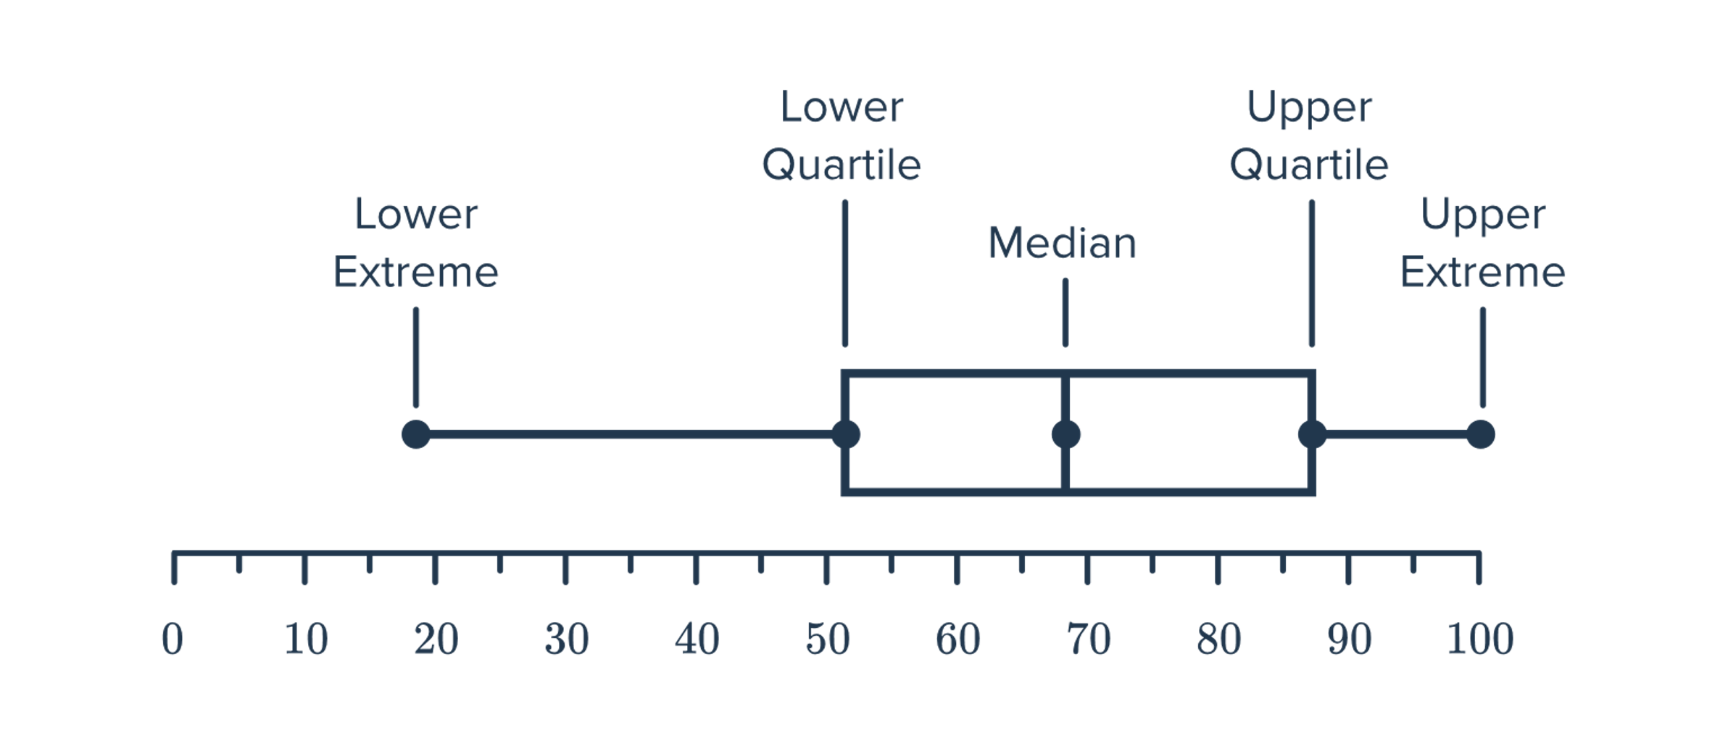
Upper Outliers
Xioating Lu, Mayank Bambal, and Murtaza Shafiq

Slide 2

OUR METHOD
Find the best 4 kinds of models and then use the ensemble node to combine them together.
Selection Statistic: ROC
Best Logistic Regression
Best Gradient Boosting
Ensemble
Prediction
Best Neural Network
&
HP Neural

Slide 3
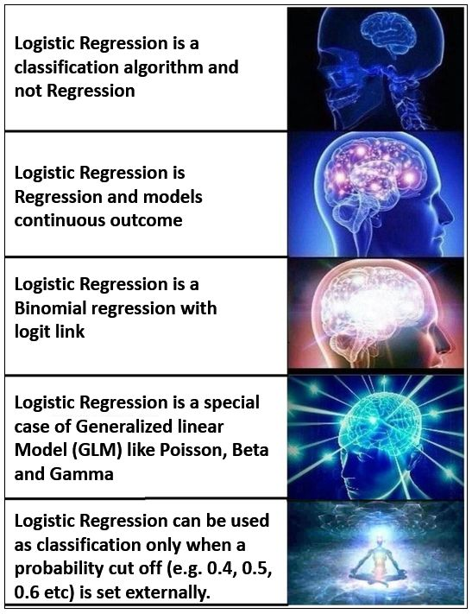
Base Model 1: Logistic Regression
Data processing:
1. Replacement
2. Filter
3. Replacement + Transform Variables
4. Filter + Transform Variables
Regression models
Data Partition
80:20
Regression models
Comparison:
Largest ROC
First, we use the default model to compare simple regression, forward selection, backward selection, lasso, and adaptive lasso.
→ replacement + simple regression is the best
Then, we add interactions to each of our regression models and then compare them again.
→ replacement + simple regression is the best ( better than without interaction)

Slide 4
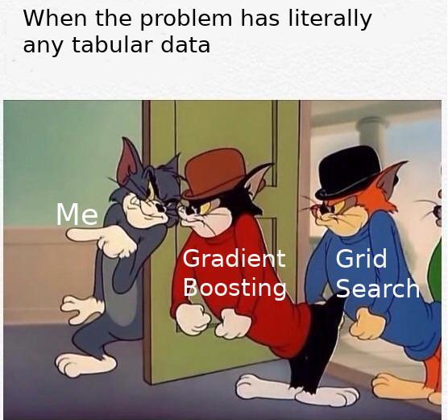
Base Model 2: Gradient Boosting
Shrinkage: 0.1
gradually increased the N iteration
Shrinkage: 0.09
gradually increased the N iteration
Shrinkage: 0.08
gradually increased the N iteration
Firstly, we set shrinkage at 0.1 then gradually increased the N iteration till the validation ASE no longer decrease.
Then, we change our shrinkage to 0.09 and do the same thing as before.
Then, set the shrinkage to 0.08, ….
Until we find the model with the largest ROC.

Slide 5
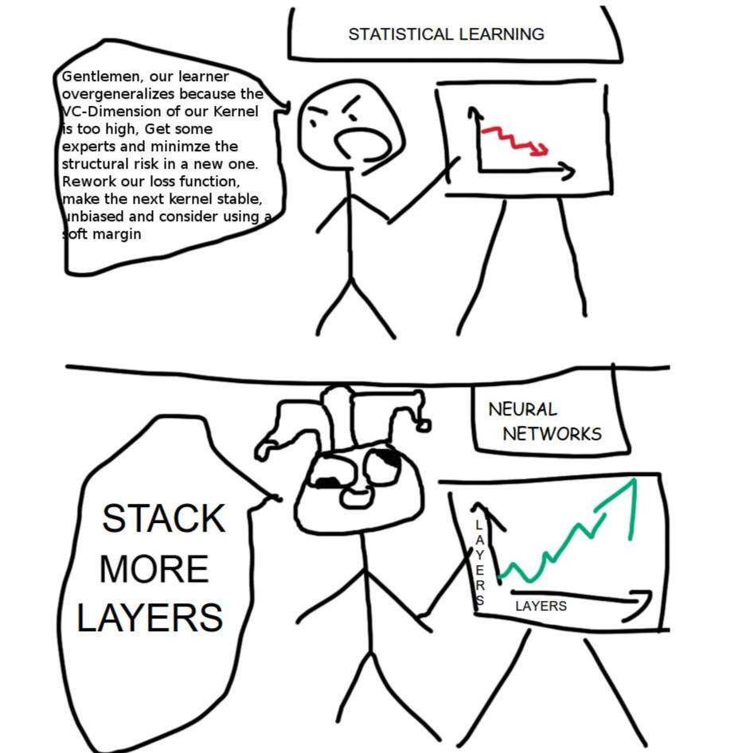
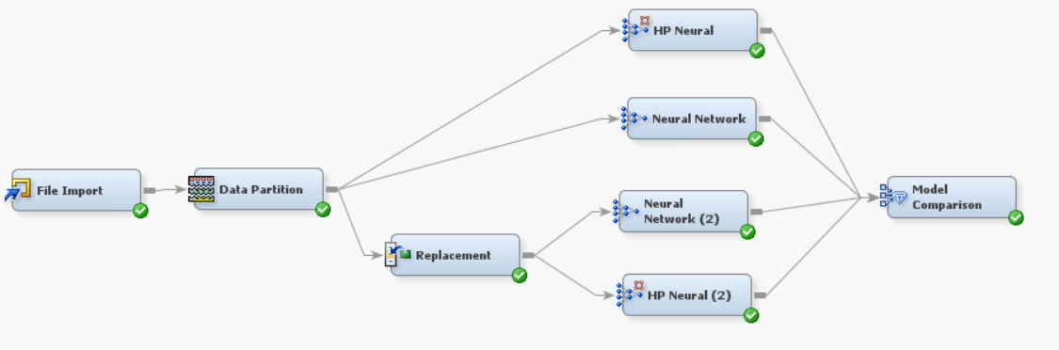
Base Model 3 & 4: Neural Network
Neural Network
A simple default Neural Network Node.
Input Standardization: Z score
Architecture: Multilayer Perceptron
HP Neural Network
In this we tried different architectures
Different types of hidden layers
Different number of hidden layers
In those we also tried different number of Neurons.
For us most accurate setup turned out to be this
Input Standardization: Range
Hidden Layers: 1
Neurons: 8

Slide 6
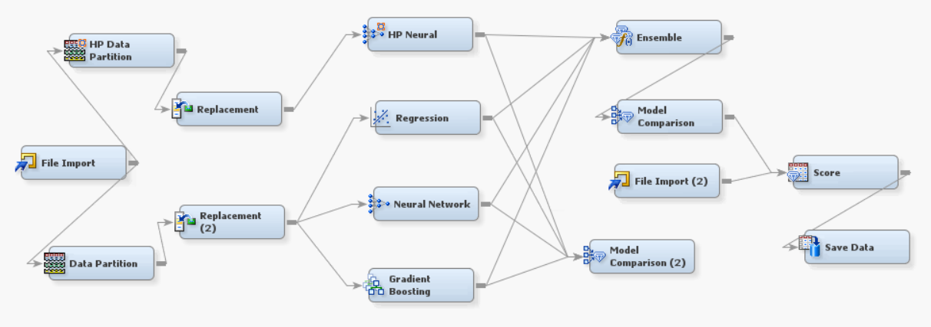
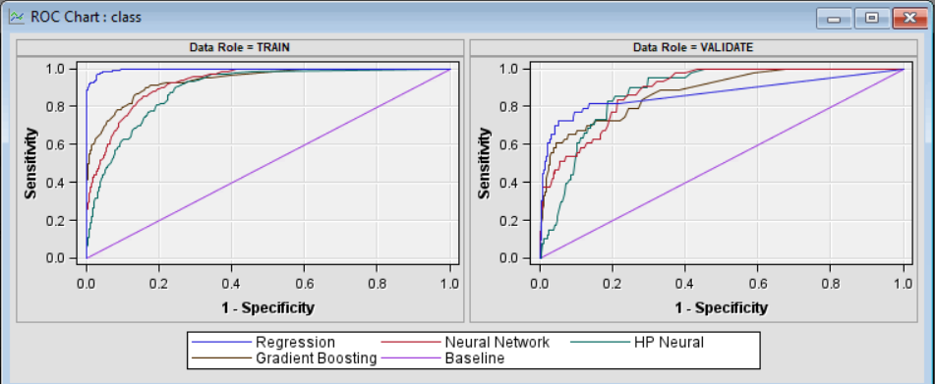
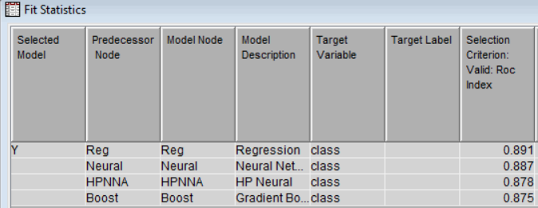
Final Model 1
This was more robust and has lower training accuracy, in case the unknown data was more different than the train and validation data this would have performed better.
Final score:
Public 0.93916
Private: 0.93556

Slide 7
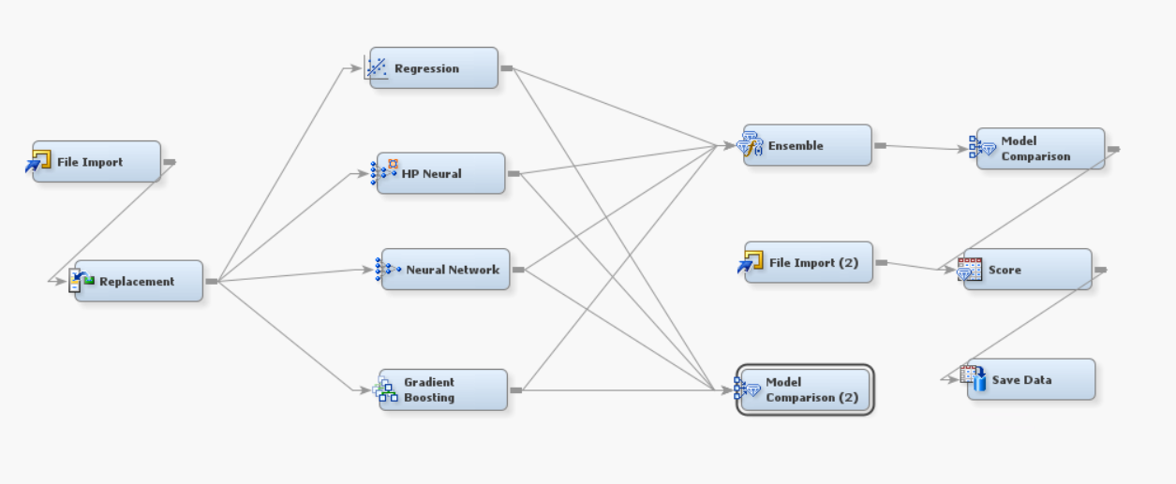
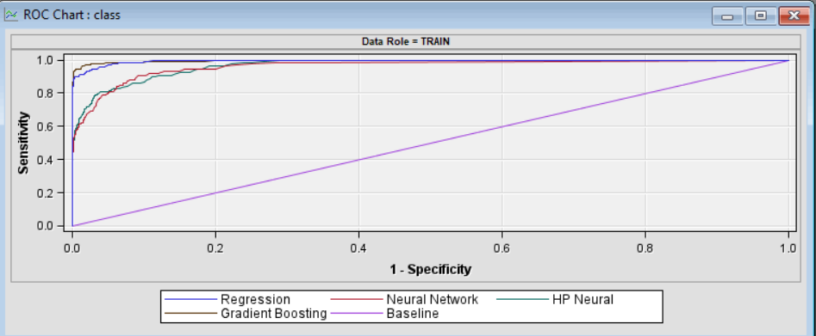
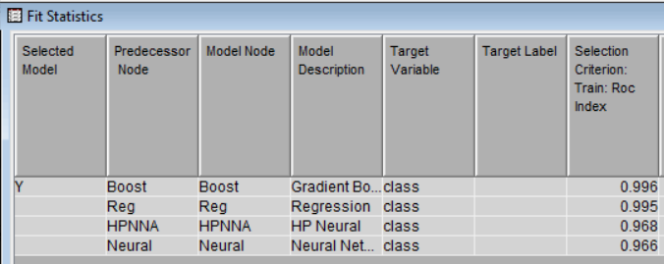
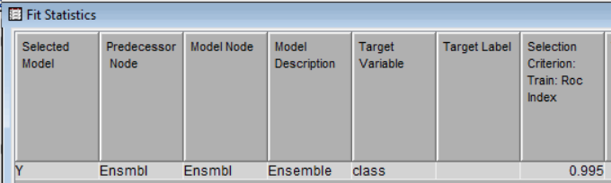
Final Model 2
For the second model, we discard the data partition step and use all data to train the model.
In this way, we can have a better-trained model, but the downside is we don’t know if our model is overfitting or not.
When we change to this way, the Kaggle score does have a big improvement!!!
Final score:
Public 0.95557
Private 0.96549

Slide 8

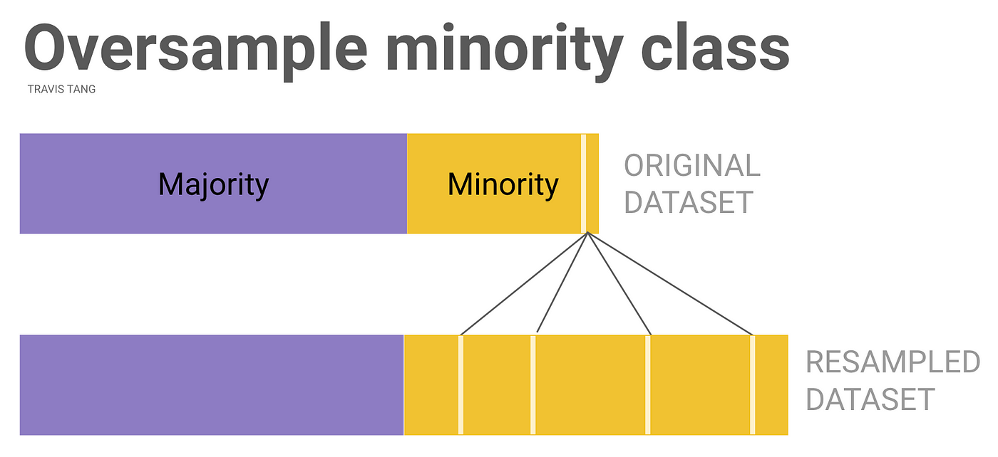

Learnings
Dataset:
We observed that data set 2 different problems
Outliers in most features
Class Imbalance(Very very very high)
Outliers were taken care using replacement node(based on standard deviation)
Learning 1 (SMOTE)

Slide 9

Learnings
Learning 2 (Simple is better)
While training neural networks, we realized the simpler models were performing better or
However, we saw in the end our base learners were just simple models with tuned parameters

Slide 10
Thank you

